Slide 1

Sales and Product Performance Dashboard Report

Slide 2

Agenda
Data Overview
Monthly Trends
Product Insights
Dashboard and Insights
Summaries
Conclusion

Slide 3

DATA SOURCE
The input data comes from the INPUTDATA and MASTER DATA sheets in the Excel file.
Product, Month, Year, Sales, Profit, Quantity, Payment Mode, Sale Type, Profit %, Pivot tables, Ranking fields, Dashboard summaries
INTEGRITY AND ACCURACY
The data is clean and tabular, with consistent headers.
All entries are monthly transactions, enabling time-based and product-based analysis.

Slide 4
Monthly Sales & Profit Trends
Month | Sales | Profit | Profit %
Jan | $ 41346.96 | $ 7056.96 | 21%
Feb | $ 30857.30 | $ 5516.30 | 22%
Mar | $ 28616.65 | $ 5179.65 | 22%
Apr | $ 26579.11 | $ 5297.11 | 25%
May | $ 30910.45 | $ 4384.45 | 17%
Jun | $ 30533.71 | $ 5654.71 | 23%
Jul | $ 35251.79 | $ 5373.79 | 18%
Aug | $ 35350.40 | $ 5519.40 | 19%
Sep | $ 35242.81 | $ 6484.81 | 23%
Oct | $ 33500.69 | $ 5658.69 | 20%
Nov | $ 36124.07 | $ 6818.07 | 23%
Dec | $ 37097.98 | $ 5963.98 | 19%
January had the highest sales ($41,346.96) and profit, indicating strong start-of-year demand or post-holiday momentum.
April had the highest profit margin (25%) despite low sales, suggesting high-margin products or reduced operating costs.
May showed the lowest profit margin (17%), likely due to higher costs, discounts, or lower-value product focus.
September to November maintained consistent sales and profit margins (~20–23%), reflecting stable business operations.
December’s sales were strong ($37,097.98), hinting at seasonal demand, but profit margin was moderate at 19%.

Slide 5
Daily Sales Trends & Transaction Breakdown
1. Daily Sales Chart (Line or Column chart)
Visualizing daily sales variation helps spot busy days, low days, and potential transaction gaps.
You can highlight spikes or dips (e.g., weekends, month-end)
2. Sales Type Breakdown (Pie or Doughnut Chart)
Retail vs Wholesale split — helps understand which channel contributes more.
3. Payment Mode Breakdown (Pie/Bar)
Show split of Cash, UPI, Credit Card, etc.
Helps assess how customers prefer to pay (business or strategic insights)

Slide 6
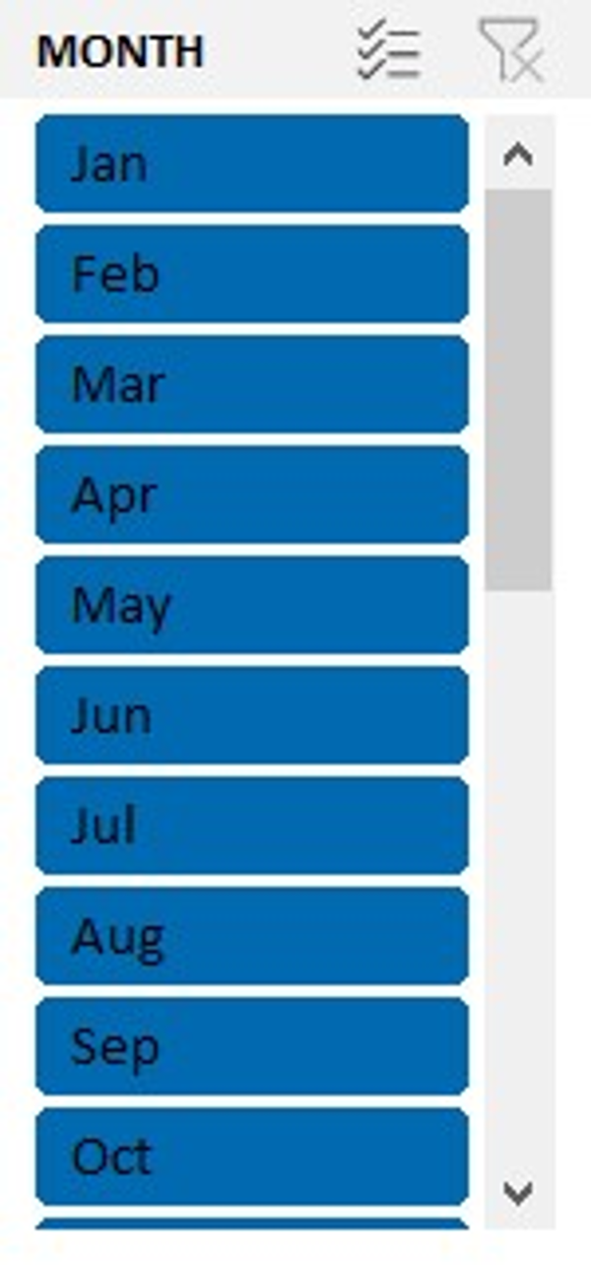
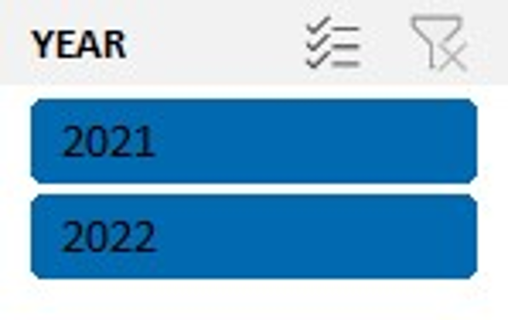
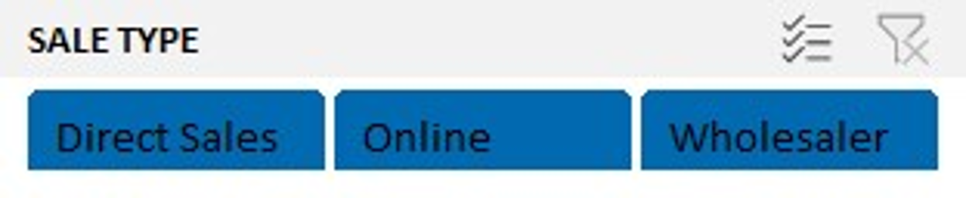
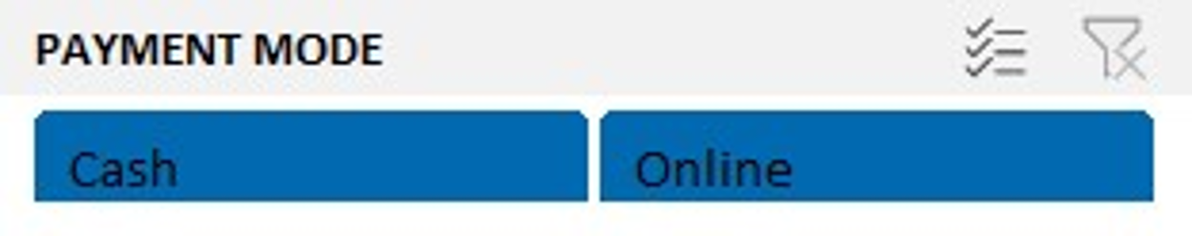
Slicers
Instantly filter all charts without writing formulas
Help users see trends by time, customer behavior, or sale category
Year | Compare annual trends, YoY growth
Month | Analyze seasonality or promotional impact
Payment Mode | See customer preferences, plan POS/payment strategy
Sale Type | Retail vs Wholesale impact on profit and quantity

Slide 7
Daily Sales Trends & Transaction Breakdown
1. Sales Type Breakdown
2. Payment Mode Breakdown
Show split of Cash, UPI, Credit Card, etc.
3. Daily Sales Chart (Line or Column chart)
Visualizing daily sales variation helps spot busy days, low days, and potential transaction gaps

Slide 8
Key Insights & Actionable Decisions
Observations from data
Business decisions or next steps
January was the best-performing month for both sales and profit.
April had the highest profit % despite lower sales volume.
Retail sales dominate, showing a preference over wholesale.
UPI and Cash are the most used payment modes — card usage is minimal.
A few products contribute to bulk of the sales — strong Pareto pattern.
Focus marketing and promotions around high-performing months like Jan & Dec.
Explore pricing or upselling strategies for April-type high-margin months.
Promote high-margin products in retail more actively.
Improve card payment options or incentives if usage is low.
Review underperforming products for potential phase-out or repositioning.

Slide 9

Summary & Future Analysis Opportunities
Final Summary Based on Data:
January was the peak month in both sales ($41,346.96) and profit ($7,056.96), indicating strong start-of-year demand.
April had the highest profit margin (25%), proving low-sales months can still yield high efficiency.
Retail sales and UPI/Cash dominate transactions, shaping customer engagement strategies.
A small group of products contributes the majority of revenue, aligning with the Pareto principle.
The dashboard offers a highly interactive experience with slicers for quick filtering and smarter decisions.

Slide 10

Predictive & Analytical Outlook:
Based on seasonal performance trends, Q1 and Q4 could be targeted for future marketing pushes.
Underperforming products and months identified here can be monitored using forecasting tools.
This dashboard structure enables easy integration with future predictive models like:
Sales forecasting using past trends
Profitability projections based on cost patterns
Customer behavior prediction via payment preferences and sale types

Slide 12
Thank you
Dashboard link
project link github
ppt link
report link

